Slide 1

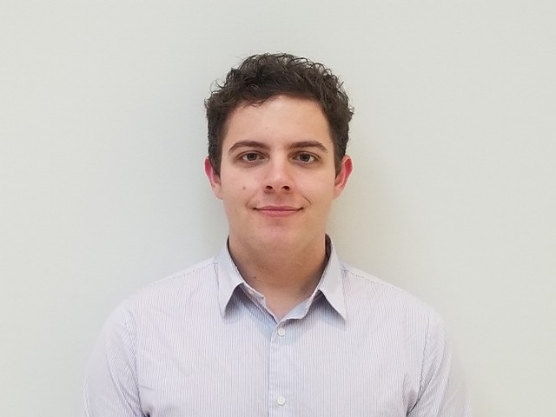
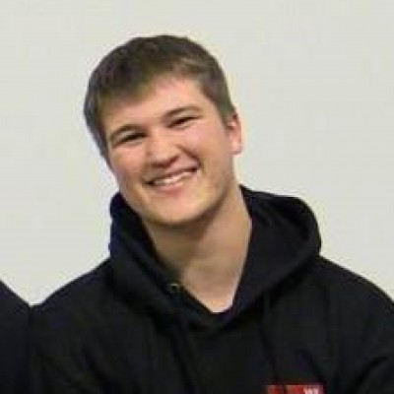
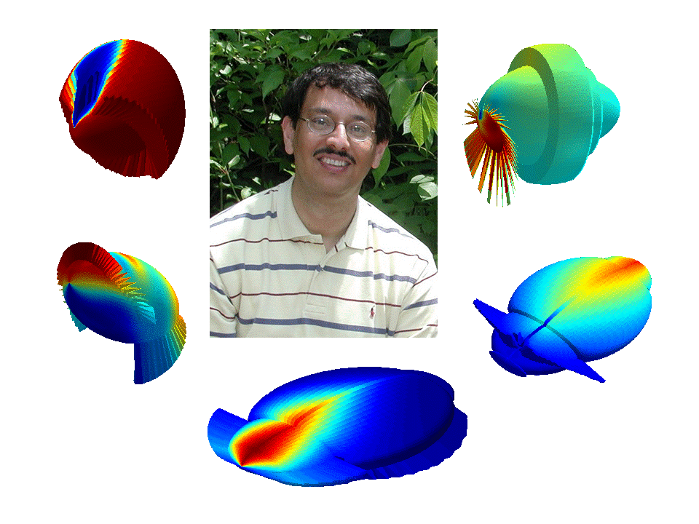
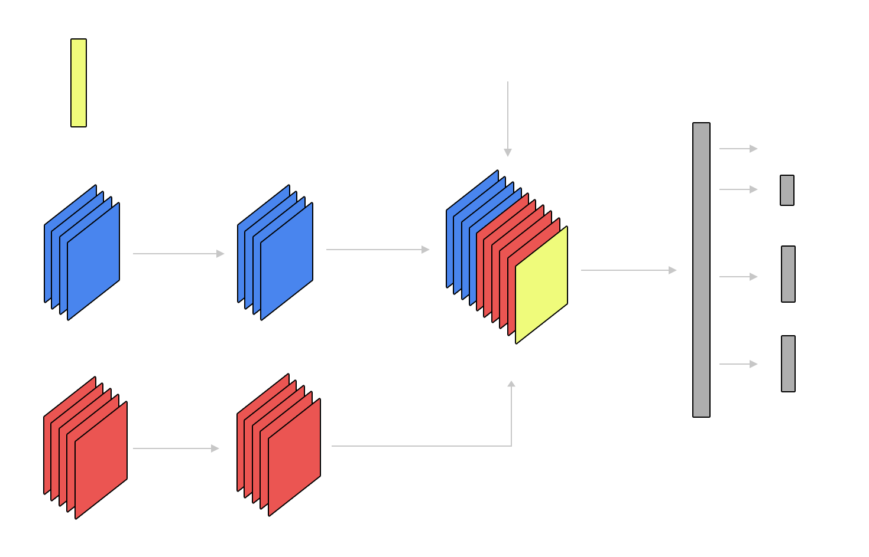
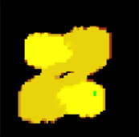
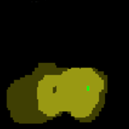
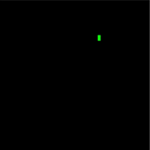

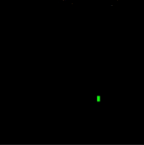

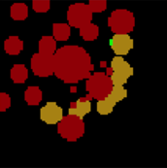

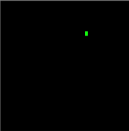
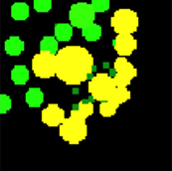
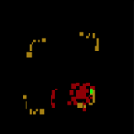
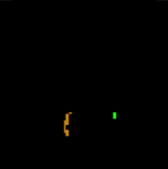



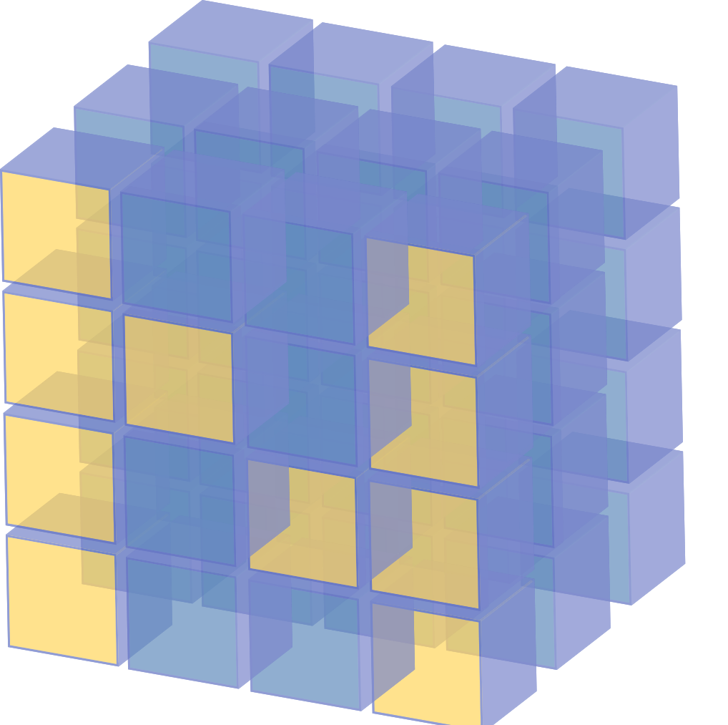
Kyle Arens
Ryan Benner
Background
Starcraft2 is a real-time, player versus player, strategy game that has two players fighting each other for victory. Real time strategy games are an interesting challenge for AI due to the presence of delayed rewards, high complexity action space, and incomplete game state knowledge (unlike Chess or Go).
Model and Input
Jon Deibel
Dr. Ali Minai
Advisor
Results
AI Type | Win Rate vs. Very Easy Random AI
Random Action | 50%
Network with Training | 84%
Interest in Problem
We wanted to pursue a topic that was related to a hobby we all shared (playing video games). Creating a AI was interesting to us because there are a variety of methods for approaching the problem and each of us had varying domain knowledge about Starcraft2. Furthermore, Blizzard and Deepmind recently released tools to aid in the development of Starcraft2 AI agents.
Minimap Layers
Milestone Achievements
10/31 – Develop scripted dumb AI.
12/05 – Develop Q-learned model capable of defeating Very Easy AI.
1/13 – Update to a deep-learned model with better success than Q-learned.
2/5 – Update to sparse and intermittent reward systems.
Screen Layers
Creep
Player Relative
Height Map
Visibility
Creep
Selected
Hit Points
Player Relative
Selected
Important Challenges
The challenges related to our project include:
Long term rewarding
Long term stochasticity
Managing Action Input Space
Real Time Action Selection
To account for some of these challenges, we developed a deep action critic model.
Future Work
Expand action space to the full possibility of Terran’s actions.
Train against multiple maps.
Train AI to change camera location.
Train AI to play as other races

